Slide 1
Things to consider in choosing mutual fund
1.It shd be always in top 25
2. Track record always may not be best indicator, fund manager plays an important role, new fund manager might not perform well
3.If fund manager manages all schemes effectively then he is best
4. AUM earlier and compare with present AUM shd be less
Large cap, multi aum < 5000cr
Mid cap,small aum < 2000 cr
5. risk vs return
Return with less risk is prefer thank high risk
Large cap with 20% return over 10 years is better than mid cap with 21% over same period

Slide 2
We can opt SIP with 1000 / month
Check company prospects
check whether mf is for long term or short term based, how it is designed
What is risk factor and track record of mf
What are the return over last years
Track record of fund manager
What are the fees and taxes

Slide 3
You can invest lump sum amount or using sip
NAV net asset value it is the value of each mf
AMC = asset management company
Every mf have bench mark which is part of sensex or nifty
We have to check our mf performance using this benchmark

Slide 4
Sip is for new customers
Mf short selling is allowed in India
We can convert the mf from balanced to debt and other types
Redemption
We buy mfs in terms of units and each unit have a set price decided by fund manager

Slide 5
We have fund manager to manage our mfs
Every mf have pros and cons
NAV = (assets – liabilities) /shares out standing
We will new nav on every day at the closing of the market
Nav is the price of each unit, if we have 500 units and nav is 10 then values of 500 units is 5000rs
All mfs are under sebi

Slide 6
risk
Risk return trade off
Market risk
Credit risk
Inflation risk
Interest rate risk
Political / govt policy risk
Liquidity risk

Slide 7
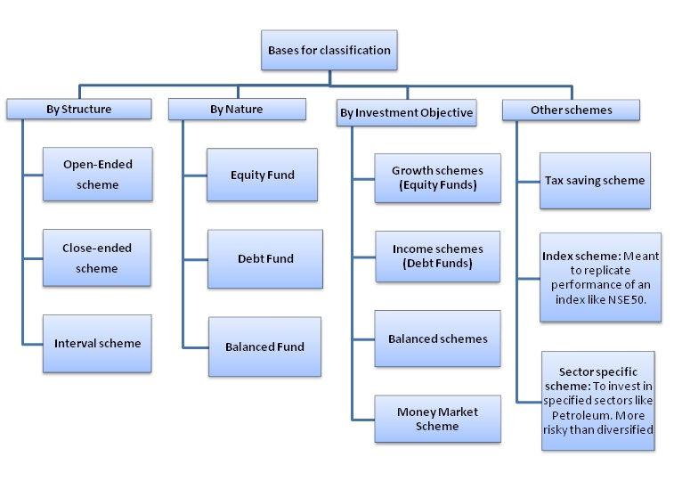

Slide 8
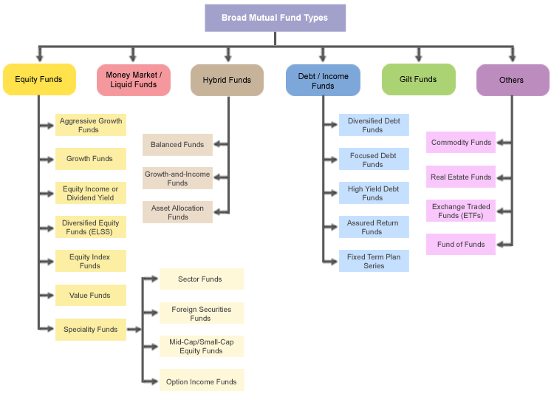

Slide 9
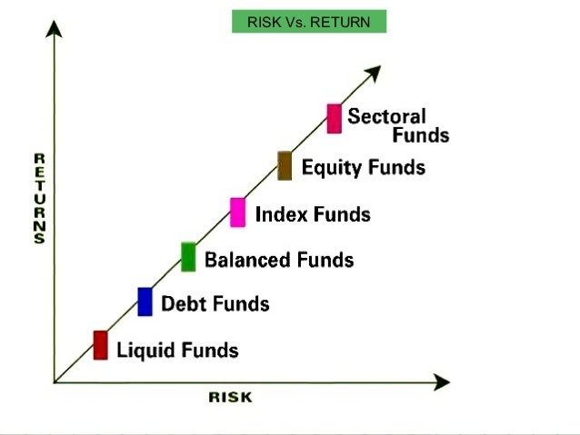

Slide 10
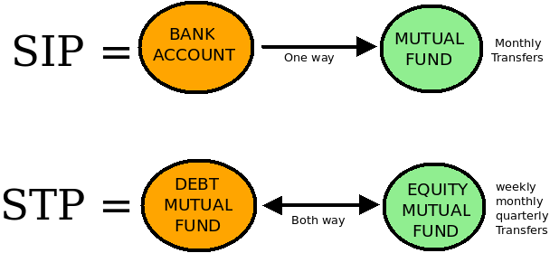

Slide 11
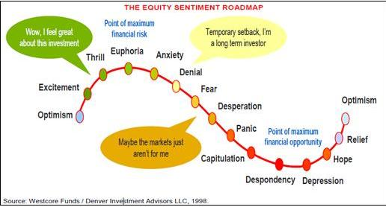

Slide 12
diversification
don't invest in mf which are not performing good
Investing in all sectors irrespective of market trend is bad practice
Investing in mf which are low unit value is a bad practice
Following the market trend and out performing sector mf will be best bet.
Balancing the portfolio according to market status is diversification
It is a myth that you shd have all kinds of mfs such that if you get loss in one you can be saved by other kind of mf

